Slide 1
Agile Software Dev
J. Blake Denouden & Jacob Brand

Slide 2

Introduction
Team members
Jacob Brand
Blake Denouden
Why this project?
An Interest in Flutter
What is flutter?
Building our individual and team skills
Develop an Application to pitch to the Air Force
(*No affiliation or endorsement by AF*)

Slide 3
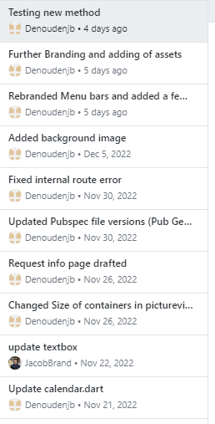
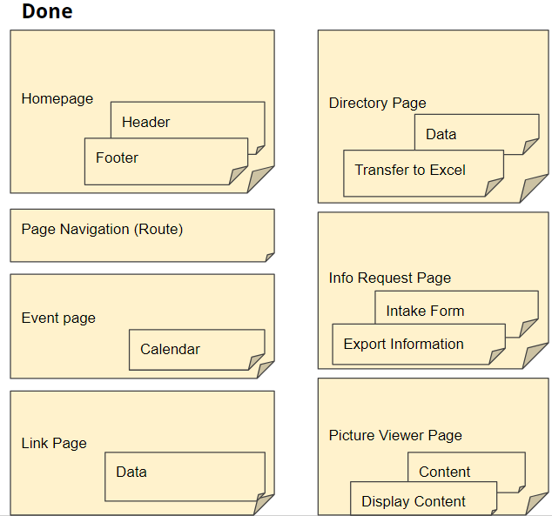
PLanning
Schedule
Met x1-2 times weekly(outside of class)
Individually dedicated 3-4 hours a week
Management
GitHub
Commit comments
Slack
Google Collab Deck

Slide 4
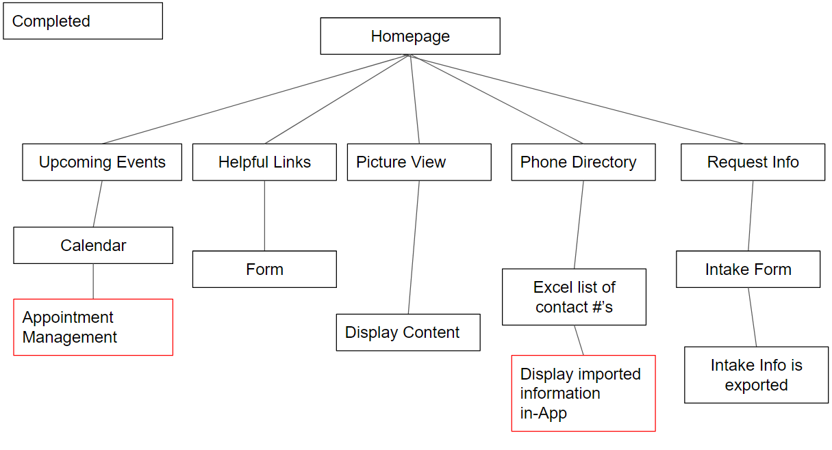
Architecture
Overview/Goals
Collaboration Application // Defining Success
Drive engagement with members of the organization
Communication & Coordination are essential elements
Share project information/pictures
Difficulties
Language familiarity
Technical difficulties
Ie. Mac/PC/Android
Time management

Slide 5
Demo

Slide 6

Future Work
Items to improve
Calendar scheduling
Link management
Better integration w/ outside resources
Display Excel sheet Inside of App
Feedback

Slide 7
Feedback?

